Slide 1
Session 4
Perfect People!

Slide 2
Beat the Running man!
You are about to be presented with 5 questions
Each question has 4 answers
You have the time it takes for the running man to cross the screen to decide which answer is correct
Get your card ready to show your answers!
Get Ready!
Press space bar or click mouse to start

Slide 3
Question 1: The number of employees a line manager is responsible for is known as what?
a) Extension of employess
b) Range of human resources
c) Web of workers
d) Span of control
Time up!
Press space to move to next question

Slide 4
Question 2: Which of the following is an example of a ‘fringe benefit’?
a) Good basic salary
b) Private healthcare
c) Regular praise/feedback
d) Training provided
Time up!
Press space to move to next question

Slide 5
Question 3: Which of these is NOT an advantage of good motivation
a) Staff turnover will rise
b) Quality of work will improve
c) Productivity will increase
d) Staff turnover will fall
Time up!
Press space to move to next question

Slide 6
Question 4: Which of the following is a disadvantage of a tall organisational structure?
a) It means that there is a career ladder path of promotion
b) It can cause problems with communication
c) It may lead to very wide spans of control
d) It requires a lot of use of delegation
Time up!
Press space to move to next question

Slide 7
Question 5: The process of removing tiers of management from a tall structure to make it flatter is known as what?
a) De-tiering
b) Streamlining
c) Decentralisation
d) Delayering
Time up!
Press space to move to next question

Slide 8
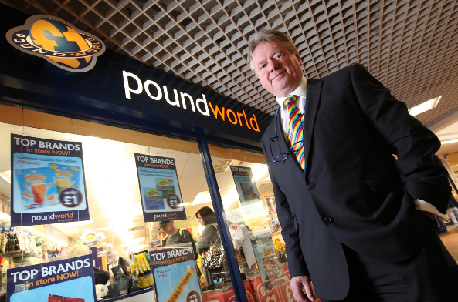
Undercover at Poundworld
Martyn Birks is a senior director at Poundworld and goes undercover to
find out what its like to work on the shop floor at one of their stores.

Slide 10
Identify one issue that Chris Edwards, the owner of Poundworld, is currently concerned about with regards to staffing at Poundworld.
High staff turnover
Issue
Cost of recruitment and training
Consequence
Problems of communication across chain of command
Issue
Not sure the passion comes across through the managers
Consequence

Slide 12
Explain one problem that may arise as a result of the demotivated staff? (3 marks)
One problem that could arise is that staff may look for jobs elsewhere and leave the company.
This could lead to the company incurring additional costs for hiring and training staff to replace those that leave, and new staff will be less productive whilst they learn the ropes.
Consequently, Poundworld will become less profitable which may lead to disgruntled shareholders.

Slide 14
Identify one reason why Malvina has difficulty in ensuring her staff feel happy and motivated.
One reason that Malvina may be finding it hard to motivate her staff is that she has a large span of control.
As a consequence, she is unable to spend time with each staff member to provide them with training and encouragement in their job.
Therefore, they do not feel valued or supported in their work and this leads to them feeling demotivated.

Slide 15
You’re the boss
Identify and explain two actions you would take to improve the motivation of staff.

Slide 16
Action 1
Explain
For example they could introduce a branch employee of the week prize so that managers could recognise good work and all staff would go the extra mile to try and win the prize. As a result, the productivity of workers may increase and they are more likely to give good customer service
I would recommend..
that Poundworld introduces a way of acknowledging staff’s effort with regular thanks or praise.

Slide 17
Action 2
Explain
Therefore, staff will feel happy with the work environment that is provided to them, and not that it’s only customers that matter. Consequently, they will feel a valued part of Poundworld and will be more likely to stay in their job. This will lead to less costs being spent on recruitment and training of new staff to replace ones who leave.
I would recommend..
that Poundworld provides better facilities for staff to take their lunch breaks.

Slide 18
The role of communication
Can you identify two examples of problems with communication
at Poundworld?

Slide 19
Can you identify two examples of problems with communication at Poundworld?
Frontline staff do not feel that managers tell them what is going on
1
There does not appear to be a method by which shop workers can feedback their concerns
2

Slide 20
Improving pay and improving communication are two methods of increasing motivation at Poundworld. Which option would be best? Justify your view (6 marks)
One argument for increasing pay is that
As a result of this
One the other hand one argument for increasing communication is
This could lead to
Overall I think improving communication is the best way of increasing motivation
this will make a job at Poundworld more attractive to a wider range of people.
They will have a wider range of candidates to choose from, some of whom will have even better skills/experience. Therefore they will be able to recruit a better workforce who provide a better service.
this is a much cheaper way of improving how staff feel about working at Poundworld.
employees feeling more involved in making decisions, and less likely to leave the business.
It will not lead to a lot of extra cost and it is important that a shop like Poundworld keeps staff costs as low as possible. It may also save costs by reducing staff turnover which will reduce recruitment and training costs.

Slide 21
Examiners Tip
Adding balance
Many of the longer response questions require you to balance your discussion. The use of a paragraph structure not only makes it easier for an examiner to read your response but it is also more likely that you will add balance. A paragraph starting with the word 'however' can help you to demonstrate this key written skill.

